Slide 1
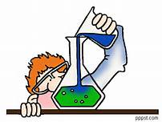
Metrology for Chemical Analysis
S.D.I Dias
Assistant Director
MUSSD

Slide 2
Overview
Metrology
Historical Back ground of Chemistry
Metrology & Chemistry
Metrology in Chemistry
Quality of a measurement result
Measurement Uncertainty
Procedure Validation
Metrological Traceability

Slide 3
Metrology
Science of measurement and its application
NOTE Metrology includes all theoretical and practical aspects of measurement, whatever the measurement uncertainty and field of application.

Slide 4
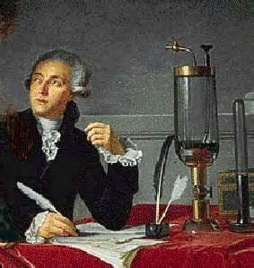
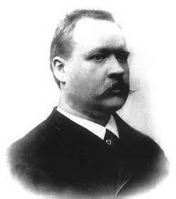
The History of Chemistry
- Chemical test are being performed since ancient Egypt (3000 BC) - Determination of gold in gold alloys by gravimetry;
Modern chemistry was born 200 year ago with Lavoisier;
- Arrhenius proposed that chemical reactions in solution were reactions between ions 100 years ago…..

Slide 5
Chemistry and Metrology
The interest of the metrology community towards chemistry started quite late,
compared to “Physical” metrology.
The mole, the unit of amount of substance, was introduced in the SI only in 1971.

Slide 6
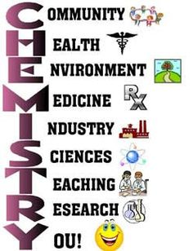
Importance of Chemistry
Technical administration
Environmental Science
Materials
Science
Chemistry
Biological Science
Medicine
Forensic Science
Pharmaceutical
Science

Slide 7
The Metrological Approach
Approach in Analytical Chemistry
Traditional
Metrological
Some principles
are the remain same…..
are improved !
are changed !

Slide 9
Metrology in Chemistry (MiC)
Is related to the fundamentals of analytical chemistry
Is needed to obtain quality measurement results
Is the responsibility of every laboratory performing the measurement

Slide 10
Quality of a measurement result depends on
Uncertainty
Validation & Traceability

Slide 11
Measurement uncertainty
Non-negative parameter characterizing the dispersion of the quantity values being attributed to a measurand, based on the information used.

Slide 12
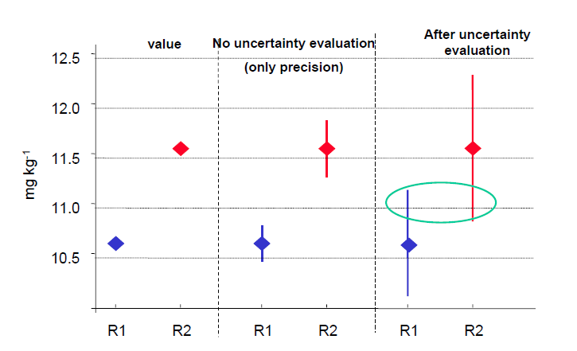
Why do we need uncertainty ?
to check the compatibility between two measurement results !
Compatibility ?

Slide 13
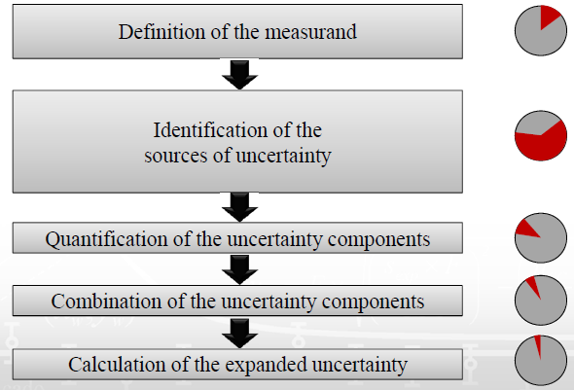
Steps of the evaluation of the measurement uncertainty
Time Scale

Slide 14
Uncertainty Approaches
Definition of the Measurand
Single laboratory
Inter laboratory
Model-based ?
One procedure ?
Yes
No
Yes
No
Modeling
Component by Component Evaluation
ISO GUM
Single lab
Validation
Within-lab reproducility & Bias
NordTest
Interlaboratoy Validation
Reproducibility and Bias
ISO 5725
ISO TS 21748
Proficiency Testing (PT)
Between Lab Variability ISO Guide 43
ISO 13528

Slide 15
Comparison of the approaches
Modeling
Advanced laboratories
- Extra work usually required
- Deep knowledge required
Danger to under estimations
Promotes Thinking
Uncertainty on an Individual measurement results
Single-lab Validation
Routine laboratories
- lot of data required
- less extra work required
Realistic uncertainty estimations
Typical Uncertainty of results obtained using a procedure in the laboratory
Inter-laboratory Validation
Minimal work or knowledge required
S_{R} Value has to known
Crude Uncertainty estimates
Uncertainty of results obtained using the same procedure in different laboratories
PT Approach
Minimal work or knowledge required
Very Crude uncertainty estimation
Should be used only as first approximation

Slide 16
Choosing the approach
If you have
– Competence and time
– Data on all important influencing quantities
Use the Modeling approach
If you have
– Quality control data and results of participation in
ILC-s or CRM analysis
Use the Single-lab validation approach
• Inter-laboratory approaches are not generally recommended

Slide 17
Definitions of Validation
Validation
Verification, where the specified requirements are
adequate for an intended use (VIM 3, 2.45)
Verification
provision of objective evidence that a given item fulfills specified requirements (VIM 3, 2.44)
Validation
is the confirmation by examination and the provision of objective evidence that the particular requirements for a specific intended use are fulfilled (ISO/IEC 17025)

Slide 18
How do you do it ?

Slide 20
When is a procedure validation needed?
Selected Procedure
Yes
Already Validated
No
Confirmation
Validation
Fit-for-purpose

Slide 21
Validation parameters
– identity, selectivity, specificity
– limit of detection (LOD)
– limit of quantitation (LOQ)
– linear range
– accuracy, trueness (recovery), precision
– sensitivity
– ruggedness/robustness

Slide 22
Residual Message
Is this Procedure fit for the purpose ?
Validation will prove it !

Slide 23
Traceability
Traceability is a property of a measurement
result whereby the result can be related to a
reference through a documented unbroken
chain of calibrations, each contributing to the
measurement uncertainty

Slide 24
Measurement Result
Physical Measurement
Chemical Measurement
Traceability

Slide 25
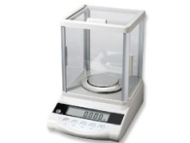
Traceability of Mass Measurement
The kg Prototype
What is Traceability?
Why do we need Traceability ?
The 6 copies of kg Prototype
Country A
Country B
The National Standard
Reference Standards of Calibration Labs
Working Standards of Calibration Labs
Working measurement Instruments
Comparable Weighing Results

Slide 26
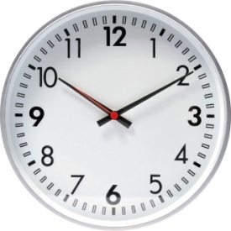
Traceability & Comparability
The whole idea of establishing traceability is comparability of measurement results!
Comparability : Property of measurement result enabling them to be compared independent of
Time Place
Two measurement results are comparable only they expressed in same units
Two measurement results are comparable, that does not mean measured quantity
values or the measurement uncertainties are in same order of magnitude

Slide 27
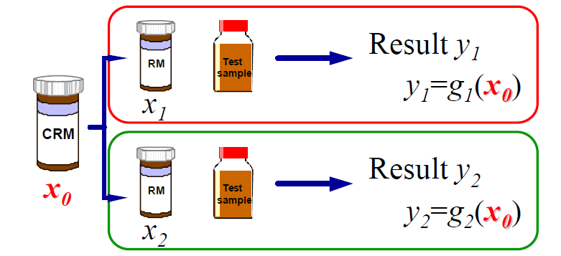
Common Reference Standard – Chemical Measurement
(Traceability in Chemical Measurement. Eurachem/CITAC Guide, 2003.)
Are Y1 & Y2 comparable?
No
Are Y1 & Y2 comparable?
Yes, through common reference

Slide 29
Residual Message
If you want comparable results ?
Demonstrate Their Traceability !

Slide 30
It is believed sometimes that the principles of metrology implies measurements at very high level and that routine analysis laboratories do not need to think about it.
Wrong!
Metrology concepts should be used in every laboratory performing measurements.

Slide 31
Measure is Pleasure !!!!
Thank You !!!!

